Slide 1
Announcements
Weekly Meetings
Commuter Bible Study – Wednesdays at 3 PM in library (led by Rich)
Ladies Bible Study/hang out/discussion – Mondays @ 3:30
Prayer – Mondays at 10:15 in Tully’s

Slide 2
Game Night at Rich’s – April 13
Parents’ Night – Invite your Parents to CSF – April 19
End of Year Party – ice cream and more – April 26 at 6 PM!

Slide 4
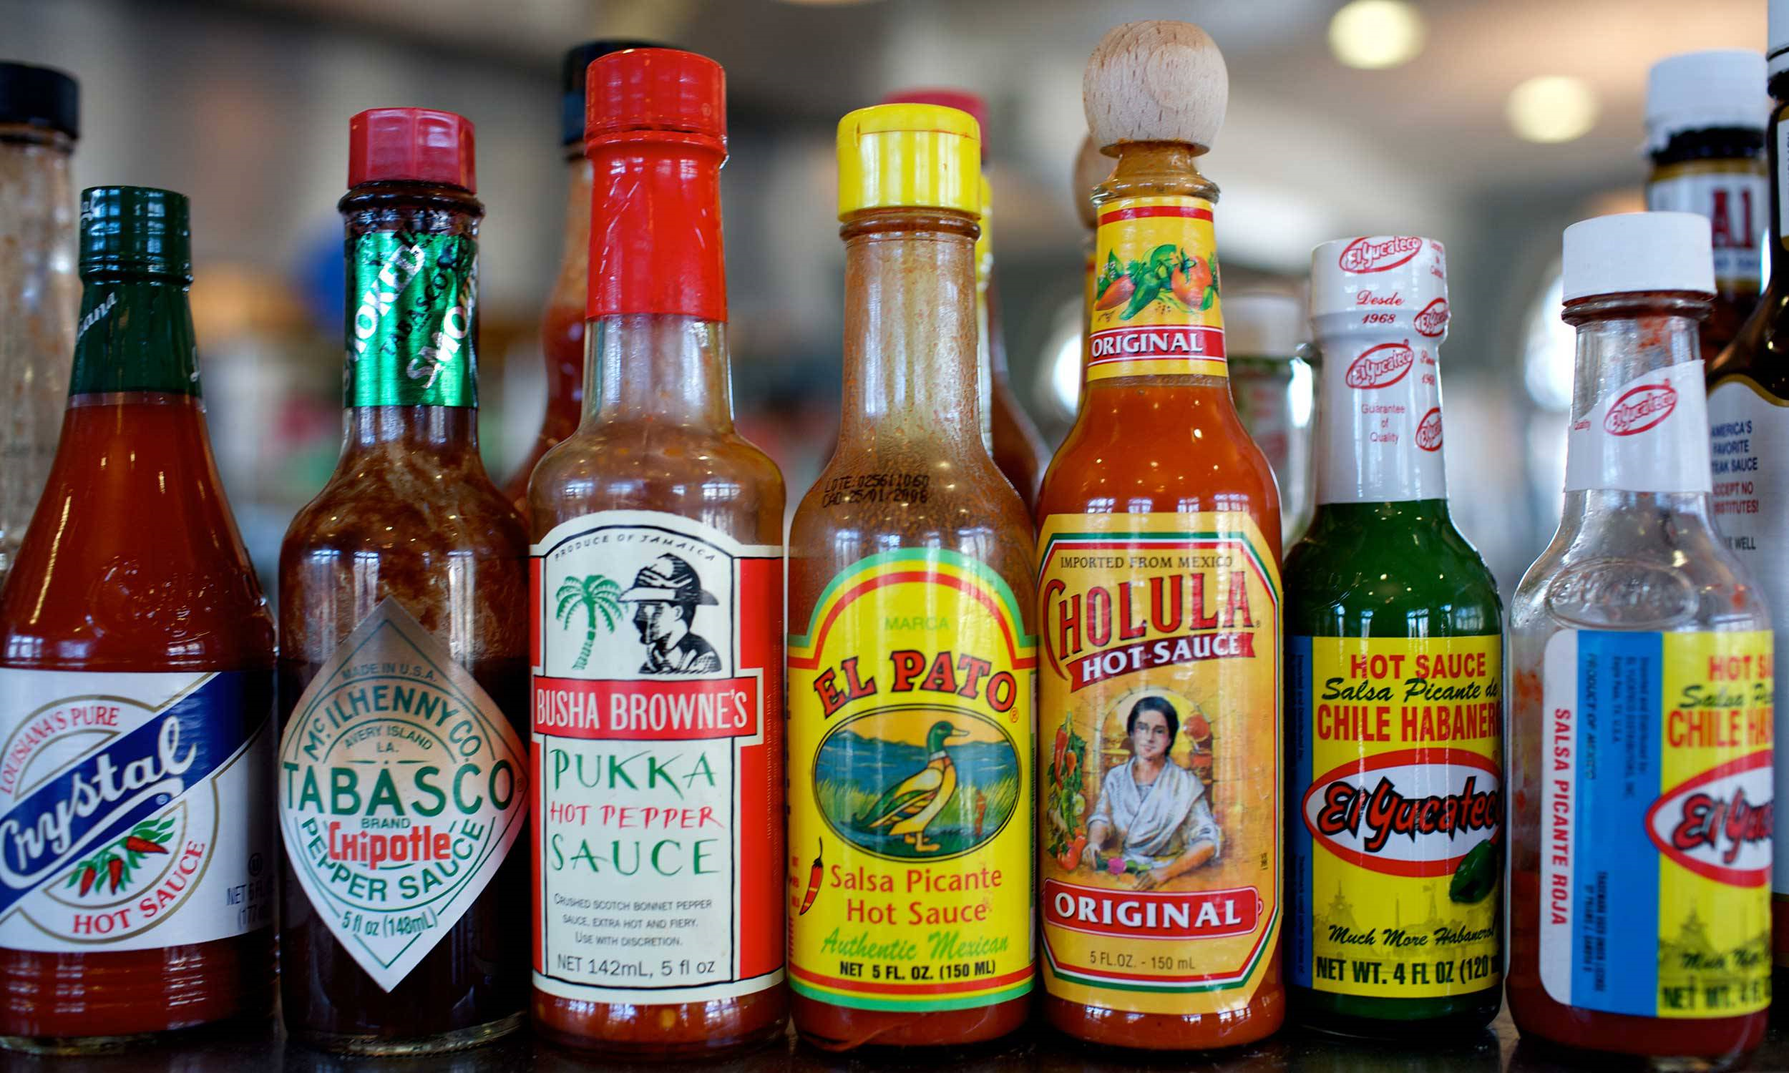
Hot Topics
Discussing the Questions Everyone is Asking

Slide 5
How can a good God torture people in hell for ever and ever?

Slide 6
A Good God Cannot Ignore Evil and Suffering
What is Judgment?
Historic Christian Understandings of Hell
Hell and Heaven in Context
Take Aways

Slide 7
A Good God Cannot Ignore Evil and Suffering
What is Judgment?
Historic Christian Understandings of Hell
Hell and Heaven in Context
Take Aways

Slide 8
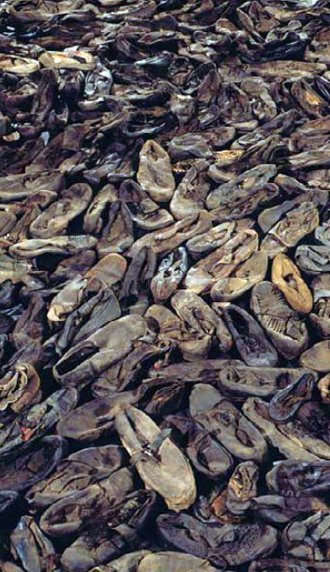
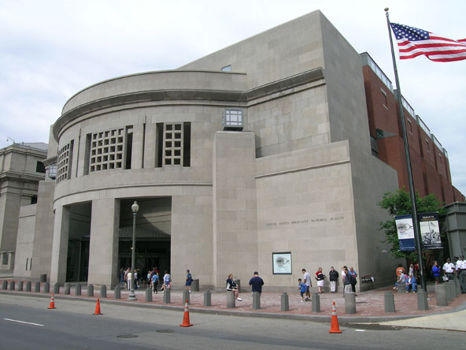

Slide 9
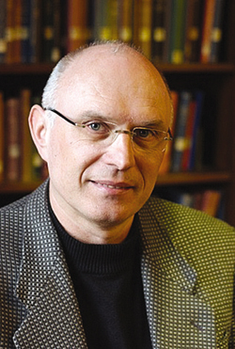
“If God were not angry at injustice and deception and did not make a final end to violence – that God would not be worthy of worship...” (303-304)

Slide 10
*Scripture reflects the visceral and emotional human response to suffering – a crying out for God to not shrug and look away but to offer a just judgment.
*This begs the question…what is judgment?

Slide 11
A Good God Cannot Ignore Evil and Suffering
What is Judgment?
Historic Christian Understandings of Hell
Hell and Heaven in Context
Take Aways

Slide 12
Judgment: Old Testament
OT speaks very little of any sort of after-death punishment
People die and go to Sheol – the place of the dead
This does not mean there is no after-death punishment since the OT does not speak of a lot of things which are central to Christian belief

Slide 13
Judgment: Old Testament
Judgment in the OT focuses on destruction within this world
Noah’s Flood (Genesis 6-9) and Destruction of Sodom and Gomorrah (Genesis 19)
Psalm 1:4-6 – Wicked blown away like dust
Psalm 37:20 – Wicked consumed in fire

Slide 14
Judgment: Jesus
Jesus speaks the most about hell
Like anything else, we need to examine what Jesus meant
Key – Jesus threatened hell exclusively on religious insiders
Hell is a warning for the holy hypocrites, not the searching seekers

Slide 15
Judgment: Jesus
Jesus speaks the about hell
Word for hell = Gehenna
Gehenna was the place where Israel committed its worst sins

Slide 16
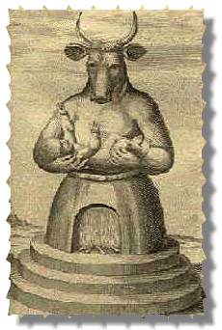
“Ahaz was twenty years old when he became king, and he reigned in Jerusalem sixteen years. Unlike David his father, he did not do what was right in the eyes of the Lord. ﻿He walked in the ways of the kings of Israel and also made cast idols for worshiping the Baals. ﻿He burned sacrifices in the Valley of Ben Hinnom and sacrificed his sons in the fire, following the detestable ways of the nations the Lord had driven out before the Israelites. ﻿He offered sacrifices and burned incense at the high places, on the hilltops and under every spreading tree.”
2 Chronicles 28:1-4

Slide 17
“Manasseh was twelve years old when he became king, and he reigned in Jerusalem fifty-five years. ﻿He did evil in the eyes of the Lord, following the detestable practices of the nations the Lord had driven out before the Israelites. ﻿He rebuilt the high places his father Hezekiah had demolished; he also erected altars to the Baals and made Asherah poles. He bowed down to all the starry hosts and worshiped them. ﻿He built altars in the temple of the Lord, of which the Lord had said, “My Name will remain in Jerusalem forever.” ﻿In both courts of the temple of the Lord, he built altars to all the starry hosts. ﻿He sacrificed his sons in ﻿the fire in the Valley of Ben Hinnom, practiced sorcery, divination and witchcraft, and consulted mediums and spiritists.
He did much evil in the eyes of the Lord, provoking
him to anger.” 2 Chronicles 33:1-6

Slide 18
“He (Josiah)desecrated Topheth, which was in the Valley of Ben Hinnom, so no one could use it to sacrifice his son or daughter in﻿the fire to Molech. ﻿He removed from the entrance to the temple of the Lord the horses that the kings of Judah had dedicated to the sun. They were in the court near the room of an official named Nathan-Melech. Josiah then burned the chariots dedicated to the sun.” 2 Kings 23:10-11

Slide 19
“So beware, the days are coming, declares the Lord, when people will no longer call it Topheth or the Valley of Ben Hinnom, but the Valley of Slaughter, for they will bury the dead in Topheth until there is no more room. ﻿Then the carcasses of this people will become food for the birds of the air and the beasts of the earth, and there will be no one to frighten them away. ﻿I will bring an end to the sounds of joy and gladness and to the voices of bride and bridegroom in the towns of Judah and the streets of Jerusalem, for the land will become desolate.”
Jeremiah 7:32-34

Slide 20
Judgment: Jesus
Jesus speaks the about hell
Word for hell = Gehenna
Gehenna was the place where Israel committed its worst sins
Gehenna (hell) provided Jesus with vivid imagery of what judgment looked like

Slide 21
Judgment: Paul
Paul speaks of judgment frequently
Uses words such as destruction and perish
Point – to be against God and to reject Jesus is to face destruction
But what is this destruction?

Slide 22
Judgment
*Christian Theology has always held that there are consequences to your actions, that rejecting God’s love in Jesus will lead to punishment.
In other words, Christians have always agree that hell exists as the negative side of the afterlife

Slide 23
A Good God Cannot Ignore Evil and Suffering
What is Judgment?
Historic Christian Understandings of Hell
Hell and Heaven in Context
Take Aways

Slide 24
1. Eternal Conscious Torment
People in hell are there forever
They are in pain and never stop feeling it
Key verses – Matthew 25:46 and Revelation 14:11

Slide 25
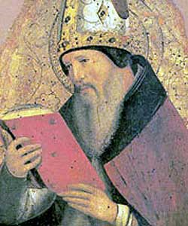
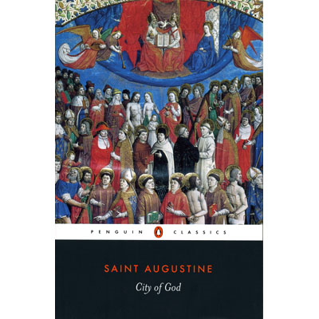
Augustine, City of God (about 420 AD)
“Those who are undergoing punishment will not know what is happening inside, in the joy of the Lord; whereas those who are in that joy will know what is happening outside, in the outer darkness.”

Slide 26
Tertullian, The Shows (about 200 AD)
“But what a spectacle is that fast-approaching advent of our Lord...that last day of judgment...How vast a spectacle then bursts upon the eye! What there excites my admiration?...Which sight gives me joy? Which rouses me to exultation?— as I see so many illustrious monarchs...groaning now in the lowest darkness...governors of provinces, too, who persecuted the Christian name, in fires more fierce than those with which in the days of their pride they raged against the followers of Christ. What world's wise men besides, the very philosophers, in fact, who taught their followers...that either they had no souls, or that they would never return to the bodies which at death they had left, now covered with shame before the poor deluded ones, as one fire consumes them! Poets also, trembling not before the judgment-seat...of the unexpected Christ...the play-actors, much more dissolute in the dissolving flame...the charioteer, all glowing in his chariot of fire...the wrestlers, not in their gymnasia, but tossing in the fiery billows...”

Slide 27
1. Eternal Conscious Torment
Key Problems
God has to actively keep people alive in hell since numerous scriptures speak of judgment as a fire that consumes.
How could any humans finite sins deserve infinite punishment?
God is worse than Hitler – all those Jews in the Holocaust went from a gas chamber to a never-ending torutre chamber.

Slide 28
2. Annihilation (Conditionalism)
People are punished in hell for a time, based on what their sins deserve, then cease to exist
Argues humans are not inherently immortal – life is a gift from God and “death” cannot mean continued life in punishment in hell
Emphasizes that if we let words mean what they mean – death, destruction, perish – this view makes most sense
Key verses: Matthew 10:28; 13:40-42; John 3:16; Galatians 6:8; 2 Peter 2:4-6

Slide 29
2. Annihilation (Conditionalism)
If this is true, how come it has been rarely believed throughout church history?
Do sinners then get what they want, to just not exist?

Slide 30
Isaiah 66:24
“And they will go out and look on the dead bodies of those who rebelled against me; the worms that eat them will not die, the fire that burns them will not be quenched, and they will be loathsome to all mankind.”
ECT – “See, the worm and the fire last forever, so people are being punished forever.”
A/C – “Yes, the fire and worm last forever, but fire consumes so the people being punished do not last forever”

Slide 31
3. Christian Universalism
Eventually all people will freely choose to love God in Jesus
Important – this is not an “all paths lead to God” view as, like other views, salvation is only in Jesus
Hell is a sort of purgatory where God continues to pursue people and never gives up.
Key verses: John 12:32; 1 Corinthians 15:22; Revelation 21:25

Slide 32
3. Christian Universalism
If this is true, why believe now?
This does not seem to work well with the many times scripture speaks of finality – whether this finality means cessation of existence or forever torment.

Slide 33
So Which is it?
Christians have disagreed forever and each position has good arguments as well as problems.
Personally, I am skeptical we can know much for sure other than:
All humans die
All humans meet God (who is a consuming fire)
We are all accountable for our sin and will be judged
Our only hope is Jesus

Slide 34
A Good God Cannot Ignore Evil and Suffering
What is Judgment?
Historic Christian Understandings of Hell
Hell and Heaven in Context
Take Aways

Slide 35
Genesis 1-2: Creation was a unity of heaven and earth
Genesis 3-11 – Creation is broken, heaven/earth unity is shattered
God’s Desire – From Tabernacle to temple through Jesus is to reunite heaven and earth

Slide 36
Creation – Matter – Matters
Jesus was born of a woman and had a real, physical body
Jesus died on the cross and rose in a new body!
Scripture promises we too will rise and have new bodies one day
(Just read 1 Corinthians 15)
WHAT HAPPENS WHEN YOU DIE IS NOT THE END OF THE STORY!
GOING TO HEAVEN WHEN YOU DIE IS NOT THE GOAL!

Slide 37
“The earth will be full of the knowledge of the Lord as the waters cover the sea” Isaiah 11:10 and Habakkuk 2:14
Then I saw a new heaven and a new earth, for the first heaven and the first earth had passed away, and there was no longer any sea. 2 I saw the Holy City, the new Jerusalem, coming down out of heaven from God, prepared as a bride beautifully dressed for her husband. 3 And I heard a loud voice from the throne saying, “Now the dwelling of God is with men, and he will live with them. They will be his people, and God himself will be with them and be their God. 4 He will wipe every tear from their eyes. There will be no more death or mourning or crying or pain, for the old order of things has passed away.”
5 He who was seated on the throne said, “I am making everything new!” Then he said, “Write this down, for these words are trustworthy and true.” Revelation 21:1-5

Slide 38
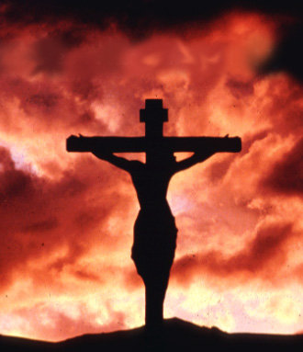
God’s Desire – From Tabernacle to temple through Jesus is to reunite heaven and earth
This will be accomplished at the end of time

Slide 39
All creation will be flooded with God’s presence…

Slide 40
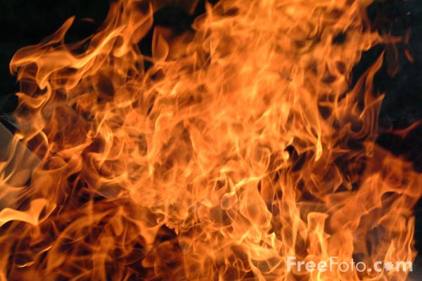
¹¹ For no one can lay any foundation other than the one already laid, which is Jesus Christ. ¹² If any man builds on this foundation using gold, silver, costly stones, wood, hay or straw, ¹³ his work will be shown for what it is, because the Day will bring it to light. It will be revealed with fire, and the fire will test the quality of each man’s work. ¹⁴ If what he has built survives, he will receive his reward. ¹⁵ If it is burned up, he will suffer loss; he himself will be saved, but only as one escaping through the flames.
1 Corinthians 3:7-15

Slide 41
God is all in all and God is a consuming Fire of Love
If God is all in all – there is no space in existence that is not flooded with God’s presence…
And if hell is separation from God…
Then what is hell…

Slide 42
God is all in all and God is a consuming Fire of Love
“The wrath of God in Scripture is a metaphor, suitable to our feeble understanding, on which describes not the action of God toward us, but what happens when the inextinguishable fervency of God’s love toward us is rejected…even hell itself is not a divine work, but the reality we have wrought within ourselves by our perverse refusal to open out – as God himself eternaly has done – in love, for God and others, for when we have so sealed ourselves up within ourselves, the fire of divine love cannot transform or enliven us, but only assail us as an external chastisement: for our God is a consuming fire” – David Bentley Hart

Slide 43
God is all in all and God is a consuming Fire of Love
God doesn’t send people to some place called hell against their will – God allows people to eternally choose a life apart from the only source of love, goodness and grace.

Slide 44
“Modern people inevitably think that hell works like this: God gives us time, but if we haven't made the right choices by the end of our lives, he casts our souls into hell for all eternity. As the poor souls fall through space, they cry out for mercy, but God says, 'Too late! You had your chance! Now you will suffer!' This caricature misunderstands the very nature of evil. The Biblical picture is that sin separates us from the presence of God, which is the source of all joy and indeed of all love, wisdom, or good things of any sort. Since we were originally created for God's immediate presence, only before his face will we thrive, flourish, and achieve our highest potential. If we were to lose his presence totally, that would be hell – the loss of our capability for giving or receiving love or joy” – Tim Keller

Slide 45
“'What if when we die we don’t end, but spiritually our life extends on into eternity?' Hell, then, is the trajectory of a soul, living a self-absorbed, self-centered life, going on and on forever” (76-77)

Slide 46
Luke 16:19-31
¹⁹ “There was a rich man who was dressed in purple and fine linen and lived in luxury every day. ²⁰ At his gate was laid a beggar named Lazarus, covered with sores ²¹ and longing to eat what fell from the rich man’s table. Even the dogs came and licked his sores.
²² “The time came when the beggar died and the angels carried him to Abraham’s side. The rich man also died and was buried. ²³ In hell, where he was in torment, he looked up and saw Abraham far away, with Lazarus by his side. ²⁴ So he called to him, ‘Father Abraham, have pity on me and send Lazarus to dip the tip of his finger in water and cool my tongue, because I am in agony in this fire.’
²⁵ “But Abraham replied, ‘Son, remember that in your lifetime you received your good things, while Lazarus received bad things, but now he is comforted here and you are in agony. ²⁶ And besides all this, between us and you a great chasm has been fixed, so that those who want to go from here to you cannot, nor can anyone cross over from there to us.’

Slide 47
²⁷ “He answered, ‘Then I beg you, father, send Lazarus to my father’s house, ²⁸ for I have five brothers. Let him warn them, so that they will not also come to this place of torment.’
²⁹ “Abraham replied, ‘They have Moses and the Prophets; let them listen to them.’
³⁰ “‘No, father Abraham,’ he said, ‘but if someone from the dead goes to them, they will repent.’
³¹ “He said to him, ‘If they do not listen to Moses and the Prophets, they will not be convinced even if someone rises from the dead.’”

Slide 48
*The rich man – even in hell – is not repentant!
He still sees Lazarus as a servant.
“In short, hell is simply one's freely chosen identity apart from God on a trajectory into infinity” (Keller, 78)
Romans 1:24-25
24 Therefore God gave them over in the sinful desires of their hearts to sexual impurity for the degrading of their bodies with one another. 25 They exchanged the truth of God for a lie, and worshiped and served created things rather than the Creator—who is forever praised. Amen

Slide 49
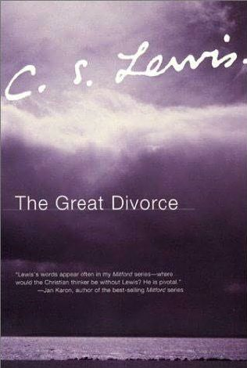
“There are only two kinds of people in the end: those who say to God, 'Thy will be done,' and those to whom God says, in the end, 'Thy will be done.” All that are in hell, choose it. Without that self-choice there could be no hell. No soul that seriously and constantly desires joy will ever miss it. Those who seek find. To those who knock it is opened” (75).

Slide 50
God is all in all and God is a consuming Fire of Love
Hell is the freely chosen life oriented away from God – and thus away from love, goodness, peace, joy and beauty – on into eternity.

Slide 51
A Good God Cannot Ignore Evil and Suffering
What is Judgment?
Historic Christian Understandings of Hell
Hell and Heaven in Context
Take Aways

Slide 52
Take-aways
1. Believe because of Beauty of Jesus - not fear of Hell
Christian preaching in Acts is never based on threat of hell – threat of hell ought not play much role in evangelism
Early Christians thought people should believe in Jesus because he really rose – we should also believe because it is true

Slide 53
Take-aways
2. Selfishness kicked to the future is still selfishness
Do you need people to suffer forever for you to believe? Do you think such selfish faith will save you?
Jesus called on his followers to do what is right because it is right, not to get something or out of fear (Luke 14:15-23)

Slide 54
Take-aways
3. God Does not send People to Hell – people choose life without God
Invite people to experience the love and beauty of Jesus.

