Slide 2
Announcements
Weekly Meetings
Commuter Bible Study –Tuesdays (Time TBA) for details talk to Rich
Karissa – ladies Bible Study/hang out/discussion
Prayer Breakfast – TBA

Slide 3
Stories: The Intersecting Stories that Shape Who We Are
This semester CSF will be reading a book by our own Pastor Dave! The goal of this book is to tell the story of the Bible in a way that gives a better understanding of how God has worked since the beginning, as well as how the story connects to life. You can read it on your own, it is only a few pages each week. Or you can join discussion groups (times and dates TBA)

Slide 4
Fun Activities…coming soon
Ice skating
Go-carts
Paintballing

Slide 5
Spring Break – Jonesville, Virginia – Working with Appalachia Service Project
Cost = $200 ----- Please pay $100 by Jan 25
Deadline to sign up – Jan 25 – then we pass the spots on to PSU Brandywine

Slide 7
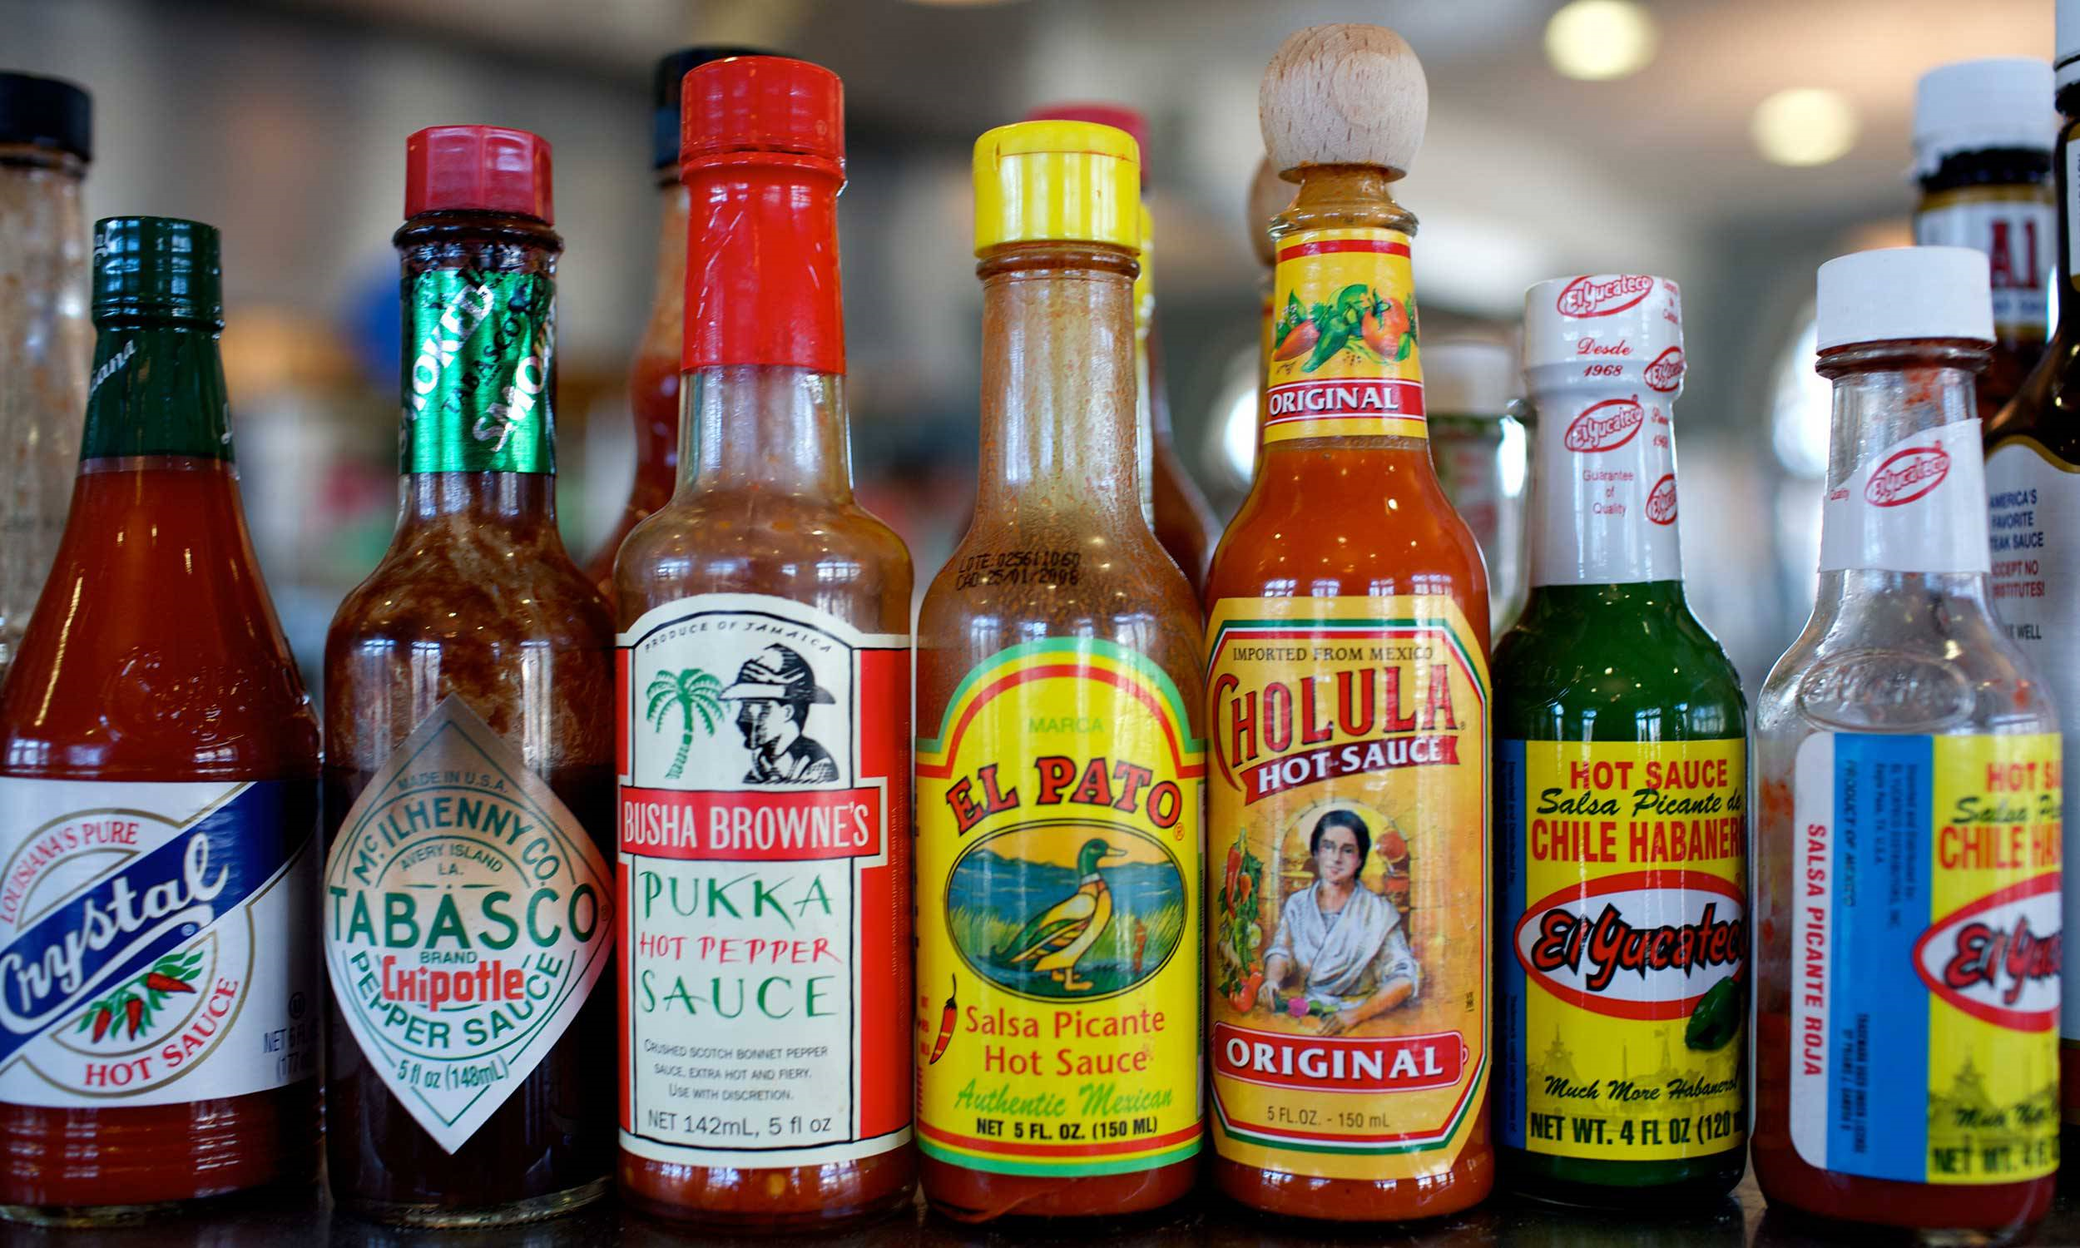
Hot Topics
Discussing the Questions Everyone is Asking

Slide 8
"How do I bring Christianity into my life as a college student; grow in my relationship with Jesus?"

Slide 9
Do we have free will?
In other words, can we even choose to bring faith into our lives or are other forces controlling us?

Slide 10
Roy Baumeister Florida State University
"At the core of the question of free will is a debate about the psychological causes of action. That is, is the person an autonomous entity who genuinely chooses how to act from among multiple possible options? Or is the person essentially just one link in a causal chain, so that the person’s actions are merely the inevitable product of lawful causes stemming from prior events, and no one ever could have acted differently than he or she actually did? …To discuss free will in terms of scientific psychology is therefore to invoke notions of self-regulation, controlled processes, behavioral plasticity, and conscious decision-making."

Slide 11
Patrick Haggard
"We don't have free will, in the spiritual sense. What you're seeing is the last output stage of a machine. If you see a light go green, it may mean press the accelerator; but there are lots of situations where it doesn't mean that: if the car in front hasn't moved, for example. The same stimulus sometimes makes me press the accelerator, but sometimes the horn. We are not one output-one input beings; we have to cope with a messy world of inputs, an enormous range of outputs. I think the term 'free will' refers to the complexity of that arrangement."

Slide 12
Sam Harris
“Free will is an illusion. Our wills are simply not of our own making.”
“You can do what you decide to do — but you cannot decide what you will decide to do.”

Slide 13
John Calvin
"Truly God claims, and would have us grant him, omnipotence - not the empty, idle, and almost unconscious sort that the Sophists imagine, but a watchful, effective, active sort, engaged in ceaseless activity...he is deemed omnipotent...because governing heaven and earth by his providence, he so regulates all things that nothing takes place without his deliberation...Let him therefore, who would beware of this infidelity ever remember that there is no erratic power, or action, or motion in creatures but that they are governed by God's secret plan in such a way that nothing happens except what is knowingly and willingly decreed by him" (Institutes of Christian Religion, 1.16.3)

Slide 14
John Calvin
"Truly God claims, and would have us grant him, omnipotence - not the empty, idle, and almost unconscious sort that the Sophists imagine, but a watchful, effective, active sort, engaged in ceaseless activity...he is deemed omnipotent...because governing heaven and earth by his providence, he so regulates all things that nothing takes place without his deliberation...Let him therefore, who would beware of this infidelity ever remember that there is no erratic power, or action, or motion in creatures but that they are governed by God's secret plan in such a way that nothing happens except what is knowingly and willingly decreed by him" (1.16.3)

Slide 15
John Calvin
"Let us imagine, for example, a merchant who entering a wood with a company of faithful men, unwisely wanders away from his companions, and in his wandering comes upon a robber's den, falls among thieves, and is slain. His death was not only foreseen by God's eye, but also is determined by his decree. For it is not said that he foresaw how long the life of each man would extend, but that he determined and fixed the bounds that men cannot pass" (1.16.9)

Slide 16
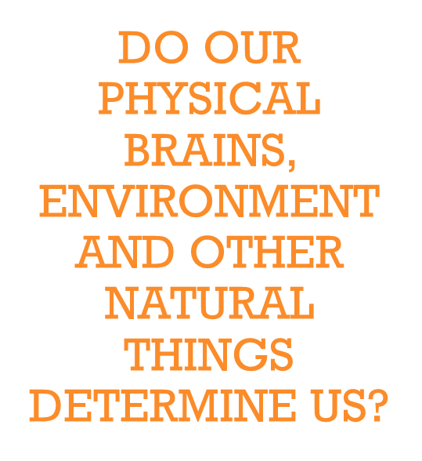
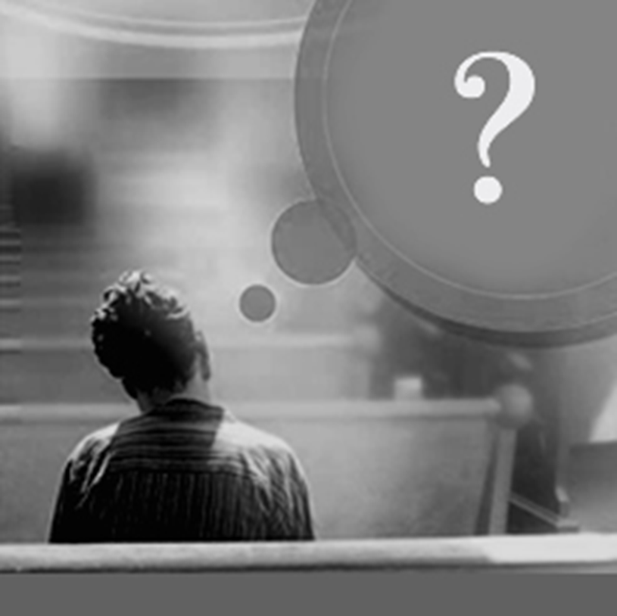
Does God determine us?

Slide 17
Exodus 32:9-14
⁹ “I have seen these people,” the Lord said to Moses, “and they are a stiff-necked people. ¹⁰ Now leave me alone so that my anger may burn against them and that I may destroy them. Then I will make you into a great nation.”
¹¹ But Moses sought the favor of the Lord his God. “Lord,” he said, “why should your anger burn against your people, whom you brought out of Egypt with great power and a mighty hand? ¹² Why should the Egyptians say, ‘It was with evil intent that he brought them out, to kill them in the mountains and to wipe them off the face of the earth’? Turn from your fierce anger; relent and do not bring disaster on your people. ¹³ Remember your servants Abraham, Isaac and Israel, to whom you swore by your own self: ‘I will make your descendants as numerous as the stars in the sky and I will give your descendants all this land I promised them, and it will be their inheritance forever.’” ¹⁴ Then the Lord relented and did not bring on his people the disaster he had threatened.

Slide 18
Jonah
*God sends Jonah to Nineveh to warn the Assyrians that their evil will lead to God’s punishment and judgment
*Jonah does not want to go so he flees the opposite direction – then God sends a storm, Jonah ends up swallowed by a big fish (whale?)
*Jonah agrees to go to Nineveh – he wanders the city announcing God is mad at them

Slide 19
Jonah
”When God saw what they did and how they turned from their evil ways, he relented and did not bring on them the destruction he had threatened” “But to Jonah this seemed very wrong, and he became angry. ² He prayed to the Lord, “Isn’t this what I said, Lord, when I was still at home? That is what I tried to forestall by fleeing to Tarshish. I knew that you are a gracious and compassionate God, slow to anger and abounding in love, a God who relents from sending calamity. ³ Now, Lord, take away my life, for it is better for me to die than to live.”
Jonah 3:10-4:3

Slide 20
Philippians
¹² Therefore, my dear friends, as you have always obeyed—not only in my presence, but now much more in my absence—continue to work out your salvation with fear and trembling, ¹³ for it is God who works in you to will and to act in order to fulfill his good purpose.
Philippians 2:12-13

Slide 21
Clark Pinnock
“Because God’s love never changes, God’s experience must change”
“He is not deaf, he listens; more than that, he acts. He does not act in the same way whether we pray or not. Prayer exerts an influence upon God’s action, even upon his existence. That is what the word ‘answer’ means”
Karl Barth

Slide 22
Do we have free will?
Yes…but not entirely free in every situation. We are free and responsible but our current choices are influenced by
habits, previous choices, spiritual realities, culture, etc.

Slide 23
"How do I bring Christianity into my life as a college student; grow in my relationship with Jesus?"
1. Community
2. Solitude
3. Service

Slide 24
1. Choose Community
Proverbs 27:17 - As iron sharpens iron, so one man sharpens another.
Hebrews 10:25 - Let us not give up meeting together, as some are in the habit of doing.

Slide 25
2. Solitude – make time each day
Mark 1:35 - Very early in the morning, while it was still dark, Jesus got up, left the house and went off to a solitary place, where he prayed.
Psalm 119:105 - Your word is a lamp to my feet and a light for my path.

Slide 26
Stories:
The Intersecting Stories that Shape Who We Are
Volume One: The Story of God in Scripture

Slide 27
3. Serve – Choose to Act
James 1:27 - Religion that God our Father accepts as pure and faultless is this: to look after orphans and widows in their distress and to keep oneself from being polluted by the world.
Isaiah 1:16b-17 -Stop doing wrong, learn to do right! Seek justice, encourage the oppressed. Defend the cause of the fatherless, plead the case of the widow.

Slide 28
Hot Topics
Discussing the Questions Eveyrone is Asking
Coming Up: Science and Faith, Bible Contradictions and More!

