Slide 1
Announcements
Weekly Meetings
Commuter Bible Study – Wednesdays at 3 PM in library (led by Rich)
Ladies Bible Study/hang out/discussion – Mondays @ 3:30
Prayer – Mondays at 10:15 in Tully’s

Slide 2
This night… Exodus 12
The Lord said to Moses and Aaron in Egypt, ² “This month is to be for you the first month, the first month of your year. ³ Tell the whole community of Israel that on the tenth day of this month each man is to take a lamb for his family, one for each household. ⁴ If any household is too small for a whole lamb, they must share one with their nearest neighbor, having taken into account the number of people there are. You are to determine the amount of lamb needed in accordance with what each person will eat. ⁵ The animals you choose must be year-old males without defect, and you may take them from the sheep or the goats.

Slide 3
This night… Exodus 12
⁶ Take care of them until the fourteenth day of the month, when all the members of the community of Israel must slaughter them at twilight. ⁷ Then they are to take some of the blood and put it on the sides and tops of the doorframes of the houses where they eat the lambs. ⁸ That same night they are to eat the meat roasted over the fire, along with bitter herbs, and bread made without yeast. ⁹ Do not eat the meat raw or boiled in water, but roast it over a fire—with the head, legs and internal organs. ¹⁰ Do not leave any of it till morning; if some is left till morning, you must burn it. ¹¹ This is how you are to eat it: with your cloak tucked into your belt, your sandals on your feet and your staff in your hand. Eat it in haste; it is the Lord’s Passover.

Slide 4
The Lamb of God John 1:29
The next day John saw Jesus coming toward him and said, “Look, the Lamb of God, who takes away the sin of the world!

Slide 5
The Old Rugged Cross
On a hill far away, stood an old rugged Cross The emblem of suff'ring and shame And I love that old Cross where the dearest and best For a world of lost sinners was slain
So I'll cherish the old rugged Cross Till my trophies at last I lay down I will cling to the old rugged Cross And exchange it some day for a crown

Slide 6
The Old Rugged Cross
Oh, that old rugged cross, so despised by the world, Has a wondrous attraction for me; For the dear Lamb of God left His glory above, To bear it to dark Calvary. So I'll cherish the old rugged cross, Till my trophies at last I lay down, I will cling to the old rugged cross, And exchange it someday for a crown.

Slide 7
The Old Rugged Cross
In the old rugged cross, stained with blood so divine Such a wonderful beauty I see For 'twas on that old cross Jesus suffered and died To pardon and sanctify me. So I'll cherish the old rugged cross, Till my trophies at last I lay down, I will cling to the old rugged cross, And exchange it someday for a crown.

Slide 8
Nothing But the Blood
What can wash away my sin? Nothing but the blood of Jesus; What can make me whole again? Nothing but the blood of Jesus.
Refrain: Oh! precious is the flow That makes me white as snow; No other fount I know, Nothing but the blood of Jesus.

Slide 9
Nothing But the Blood
For my pardon, this I see, Nothing but the blood of Jesus; For my cleansing this my plea, Nothing but the blood of Jesus..
Refrain: Oh! precious is the flow That makes me white as snow; No other fount I know, Nothing but the blood of Jesus.

Slide 10
Nothing But the Blood
Nothing can for sin atone, Nothing but the blood of Jesus; Naught of good that I have done, Nothing but the blood of Jesus.
Refrain: Oh! precious is the flow That makes me white as snow; No other fount I know, Nothing but the blood of Jesus.

Slide 11
Nothing But the Blood
This is all my hope and peace, Nothing but the blood of Jesus; This is all my righteousness, Nothing but the blood of Jesus.
Refrain: Oh! precious is the flow That makes me white as snow; No other fount I know, Nothing but the blood of Jesus.

Slide 12
Psalm 116:1, 10-17
I love the Lord, because he has heard the voice of my supplication, * because he has inclined his ear to me whenever I called upon him.
10 How shall I repay the Lord * for all the good things he has done for me?
11 I will lift up the cup of salvation * and call upon the Name of the Lord.
12 I will fulfill my vows to the Lord * in the presence of all his people.
13 Precious in the sight of the Lord * is the death of his servants.

Slide 13
Psalm 116:1, 10-17
14 O Lord, I am your servant; * I am your servant and the child of your handmaid; you have freed me from my bonds.
15 I will offer you the sacrifice of thanksgiving * and call upon the Name of the Lord.
16 I will fulfill my vows to the Lord * in the presence of all his people,
17 In the courts of the Lord’s house, * in the midst of you, O Jerusalem. Hallelujah!

Slide 14
In Christ Alone
In Christ alone my hope is found He is my light, my strength, my song This Cornerstone, this solid ground Firm through the fiercest drought and storm What heights of love, what depths of peace When fears are stilled, when strivings cease My Comforter, my All in All Here in the love of Christ I stand

Slide 15
In Christ Alone
In Christ alone, who took on flesh Fullness of God in helpless babe This gift of love and righteousness Scorned by the ones He came to save 'Til on that cross as Jesus died The wrath of God was satisfied For every sin on Him was laid Here in the death of Christ I live, I live

Slide 16
In Christ Alone
There in the ground His body lay Light of the world by darkness slain Then bursting forth in glorious Day Up from the grave He rose again And as He stands in victory Sin's curse has lost its grip on me For I am His and He is mine Bought with the precious blood of Christ

Slide 17
In Christ Alone
No guilt in life, no fear in death This is the power of Christ in me From life's first cry to final breath Jesus commands my destiny No power of hell, no scheme of man Can ever pluck me from His hand Till He returns or calls me home Here in the power of Christ I'll stand

Slide 18
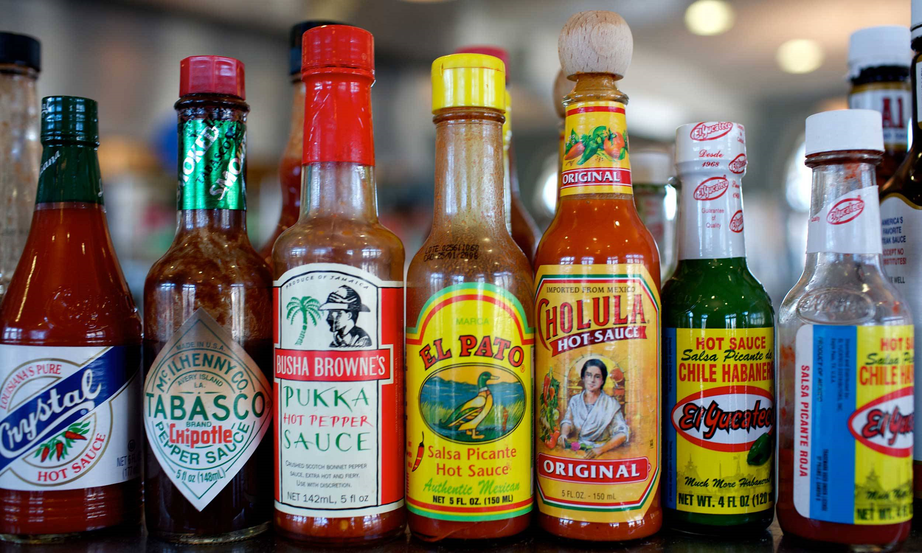
Hot Topics
Discussing the Questions Everyone is Asking

Slide 19
Is Christianity inherently violent?
Do Christians use violence to defend their faith?

Slide 20
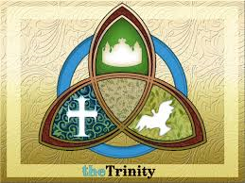
God as Trinity is not just an irrelevant Thing to believe – It tells us What God is like

Slide 21
In Jesus – God Returns to Jerusalem
*Jewish people of Jesus’ Day remembered how God had defeated Egypt and freed them
*Jewish people believed God had abandoned them due to their sin centuries before
*Jewish people yearned for God to return and destroy their enemies once again

Slide 22
Luke 19
⁴¹ As he approached Jerusalem and saw the city, he wept over it ⁴² and said, “If you, even you, had only known on this day what would bring you peace—but now it is hidden from your eyes. ⁴³ The days will come upon you when your enemies will build an embankment against you and encircle you and hem you in on every side. ⁴⁴ They will dash you to the ground, you and the children within your walls. They will not leave one stone on another, because you did not recognize the time of God’s coming to you.”

Slide 23
Luke 22
³⁶ He said to them, “But now if you have a purse, take it, and also a bag; and if you don’t have a sword, sell your cloak and buy one. ³⁷ It is written: ‘And he was numbered with the transgressors’ (Isaiah 53:12); and I tell you that this must be fulfilled in me. Yes, what is written about me is reaching its fulfillment.”
³⁸ The disciples said, “See, Lord, here are two swords.”
“That’s enough!” he replied.

Slide 24
Luke 22
⁴⁷ While he was still speaking a crowd came up, and the man who was called Judas, one of the Twelve, was leading them. He approached Jesus to kiss him, ⁴⁸ but Jesus asked him, “Judas, are you betraying the Son of Man with a kiss?”
⁴⁹ When Jesus’ followers saw what was going to happen, they said, “Lord, should we strike with our swords?” ⁵⁰ And one of them struck the servant of the high priest, cutting off his right ear.
⁵¹ But Jesus answered, “No more of this!” And he touched the man’s ear and healed him.

Slide 25
Luke 23
³² Two other men, both criminals, were also led out with him to be executed. ³³ When they came to the place called the Skull, they crucified him there, along with the criminals—one on his right, the other on his left. ³⁴ Jesus said, “Father, forgive them, for they do not know what they are doing.” And they divided up his clothes by casting lots.

Slide 26
Mark 8
³⁴ Then he called the crowd to him along with his disciples and said: “Whoever wants to be my disciple must deny themselves and take up their cross and follow me. ³⁵ For whoever wants to save their life will lose it, but whoever loses their life for me and for the gospel will save it. ³⁶ What good is it for someone to gain the whole world, yet forfeit their soul? ³⁷ Or what can anyone give in exchange for their soul? ³⁸ If anyone is ashamed of me and my words in this adulterous and sinful generation, the Son of Man will be ashamed of them when he comes in his Father’s glory with the holy angels.”

Slide 27
Is Christianity inherently violent?
Do Christians use violence to defend their faith?

Slide 28
Do you believe Jesus’ death on the cross is merely something you must believe in order for forgiveness and a way to heaven…or is it central to your entire way of life?

Slide 29
Is Jesus our clearest picture of who God is or is Jesus just one of many pictures of God?
Is Jesus God or merely a prophet?

Slide 30
Is Christianity inherently violent?
Not if we take Jesus seriously.

Slide 31
Do Christians use violence to defend their faith?
Not if we follow Jesus.

Slide 32
Luke 19
⁴¹ As he approached Jerusalem and saw the city, he wept over it ⁴² and said, “If you, even you, had only known on this day what would bring you peace—but now it is hidden from your eyes. ⁴³ The days will come upon you when your enemies will build an embankment against you and encircle you and hem you in on every side. ⁴⁴ They will dash you to the ground, you and the children within your walls. They will not leave one stone on another, because you did not recognize the time of God’s coming to you.”

Slide 33
Consequences of Turning Away from God
*Jewish people rejected Jesus’ way and chose the path of violence
*In 70 AD Roman legions destroyed Jerusalem
*They ran out of wood to crucify all the Jewish revolutionaries

Slide 34
Consequences of Turning Away from God
*God’s Commands for us are not arbitrary – God commands what is best for us
*God is the sole source of all that is good, beautiful, loving, patience, satisfying, fulfilling.
*To turn away from God is to venture into a world of death, violence, sin and evil…and it will self-destruct and you will not survive.

Slide 35
1 Corinthians 11
I received from the Lord what I also handed on to you, that the Lord Jesus on the night when he was betrayed took a loaf of bread, and when he had given thanks, he broke it and said, "This is my body that is for you. Do this in remembrance of me." In the same way he took the cup also, after supper, saying, "This cup is the new covenant in my blood. Do this, as often as you drink it, in remembrance of me." For as often as you eat this bread and drink the cup, you proclaim the Lord's death until he comes.

Slide 36
Prayer
Almighty Father, whose dear Son, on the night before he suffered, instituted the Sacrament of his Body and Blood: Mercifully grant that we may receive it thankfully in remembrance of Jesus Christ our Lord, who in these holy mysteries gives us a pledge of eternal life; and who now lives and reigns with you and the Holy Spirit, one God, for ever and ever. Amen.

Slide 37
